Slide 1
Indian Knowledge Systems
Unit – 2
Number system and Units of Measurement

Slide 2
Introduction
The number systems developed in ancient India are one of the most remarkable achievements of human intellect.
Ancient Indian mathematicians not only pioneered the development of numbers but also laid the foundation for modern mathematics and computational systems.
The Indian Knowledge System (IKS) integrates mathematics with philosophy, linguistics, astronomy, and spiritual insights, reflecting a holistic approach to knowledge.

Slide 3
Origin of Number Systems in India
The roots of the Indian number system can be traced back to the Vedic period (circa 1500–500 BCE).
The Rigveda, one of the earliest Indian texts, contains references to numbers and arithmetic operations used in rituals and measurements.
Numerical concepts were deeply embedded in religious and cultural practices, such as the construction of altars with precise geometrical shapes and dimensions.
During the later Vedic period, the Shulba Sutras (texts related to geometry and mathematics) demonstrated advanced numerical skills, including fractions, proportions, and square roots.
These texts indicate that ancient Indians had a profound understanding of numbers well before the formalization of the decimal system.

Slide 4
Decimal System and Place Value Notation
The most significant contribution of ancient India to the world of numbers is the decimal place value system.
This system, which uses ten symbols (0–9), revolutionized arithmetic, making calculations simple and efficient. The earliest evidence of the decimal system appears in inscriptions from the 3rd century BCE, such as the Ashokan Edicts.
The concept of zero (śūnya), first formalized in India, was a groundbreaking innovation. The Indian mathematician Brahmagupta(598–668 CE) was the first to describe zero as a number and laid down rules for arithmetic operations involving zero in his seminal work Brahmasphuta siddhanta.
Zero, coupled with the place value system, allowed for infinite scalability in numerical representation and calculations.
The Indian system of numbers was later transmitted to the Islamic world through scholars like Al-Khwarizmi and Al-Samawal, and eventually reached Europe, where it became the foundation of modern mathematics.

Slide 5
Large Numbers
The Shukla Yajurveda (17.2) [Chapter 17 mantra 2], has a list of names for powers of ten up to 1012. The list given in the Yajurveda text is:
eka (1)
daśa(10)
mesochi/ shatam(100)
sahasra(1000)
ayuta(10000)
niyuta(100000)
prayuta(1000000)
arbuda(10000000)
nyarbuda(100000000)
saguran(1000000000)
madhya(10000000000)
anta (100000000000)
parârdha(1000000000000)

Slide 6
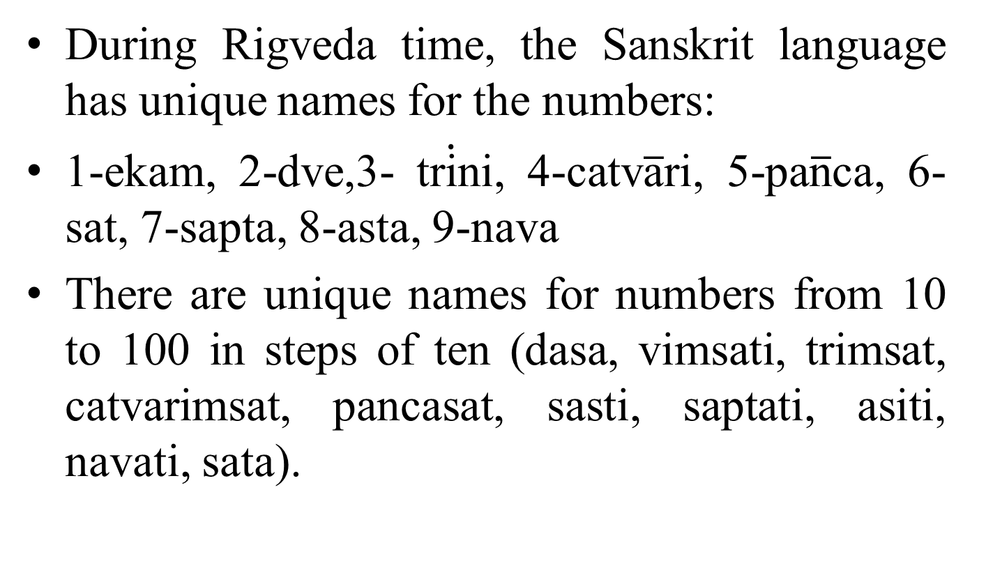
Large Numbers
During Rigveda time, the Sanskrit language has unique names for the numbers:
1-ekam, 2-dve,3- tr$\dot{\text{i}}$ni, 4-catv$\overline{\text{a}}$ri, 5-pa$\overline{\text{n}}$ca, 6-sat, 7-sapta, 8-asta, 9-nava
There are unique names for numbers from 10 to 100 in steps of ten (dasa, vimsati, trimsat, catvarimsat, pancasat, sasti, saptati, asiti, navati, sata).

Slide 7
Large Numbers
Later Hindu and Buddhist texts have extended this list, but these lists are no longer mutually consistent and names of numbers larger than 108 differ between texts.
For example, the Panchavimsha Brahmana lists 10⁹ as nikharva, 10¹⁰ vâdava, 10¹¹akṣiti, while ŚâṅkhyâyanaŚrauta Sûtrah as 10⁹ nikharva, 10¹⁰samudra, 10¹¹ salila, 10¹² antya, 10¹³ ananta. Such lists of names for powers of ten are called daśaguṇottarra saṁjñâ.

Slide 8
Large Numbers –Encounter with Siddhartha
The mathematician Arjuna asked Siddhartha: O young man, do you know the counting which goes beyond the koti on the centesimal scale? Siddhartha: Yes, I know.
Arjuna: How does the counting proceed beyond the koti on the centesimal scale?
Siddhartha: Hundred Kotis are called ayuta,
Hundred ayutas a niyuta,
Hundred niyutas a kankara,
Hundred kankaras a vivaha,
Hundred vivahas a utsanga,
hundred utsangas a bahula,
Hundred bahulas a nagabala,
Hundred nagabalas a titilambha,
Hundred titilambhas a vyavasthana - prajnapati,
Hundred vyavasthanaprajnapatis a hetuhila,
Hundred hetuhilas a karahu,
Hundred karahus a hetvindriya,
Hundred hetvindriyas a samapta-lambha,
Hundred samapta-lambhas a gananagati,
Hundred gananagatis a niravadya,
Hundred niravadyas a mudra-bala,
Hundred mudra-balas a sarva-bala,
Hundred sarva-balas a visamjna-gati,
Hundred visamgjna-gatis a sarvajna,
Hundred sarvajnas a vibhutangama,
Hundred vibhutangamas a tallaksana.
Thus a tallaksana is 10^53

Slide 9
Large Numbers –Encounter with Siddhartha
Entire universe measured in meters and then squared would be around 10^53.
This is just one of a series of counting systems that can be expanded geometrically. The last number at which he arrived at after going through nine successive counting systems was10⁴²¹, that is, a 1 followed by 421 zeros!
Siddharth mentioned that this number tallakshana forms part of one counting system. He further went on to show that eight more such counting systems are available to enumerate higher numbers. In each system there are 23 terms starting from the previous system.

Slide 10
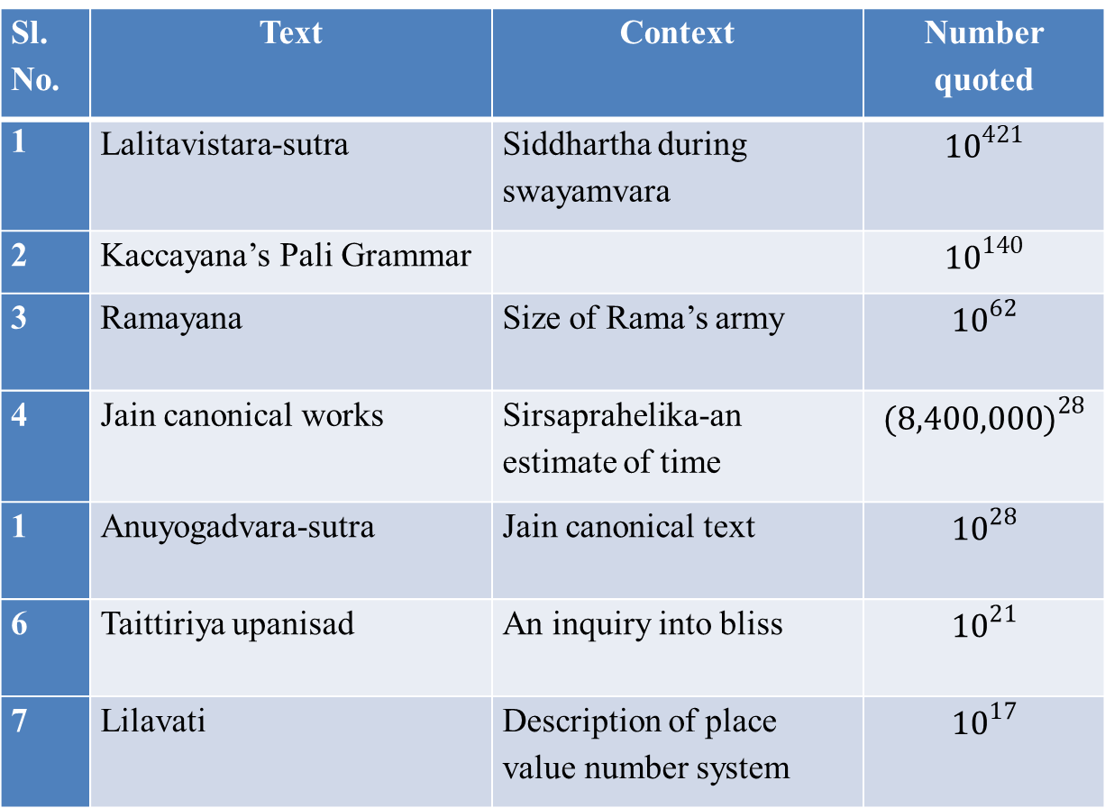
Table 6.1 : Reference to Large Numbers in Ancient Texts.
Sl. No. | Text | Context | Number quoted
1 | Lalitavistara-sutra | Siddhartha during swayamvara | $${10}^{421}$$
2 | Kaccayana’s Pali Grammar |  | $${10}^{140}$$
3 | Ramayana | Size of Rama’s army | $${10}^{62}$$
4 | Jain canonical works | Sirsaprahelika-an estimate of time | $${(8,400,000)}^{28}$$
1 | Anuyogadvara-sutra | Jain canonical text | $${10}^{28}$$
6 | Taittiriya upanisad | An inquiry into bliss | $${10}^{21}$$
7 | Lilavati | Description of place value number system | $${10}^{17}$$

Slide 11
Large Numbers –Encounter with Siddhartha
The method to get these numbers can be generalized using a formula:
(10^{(7+46*n)})*(10²)²³
When n = 0, number is 10⁵³(tallaksana)
When n = 1, number is 10⁹⁹(dhvajagravati)
…
When n = 8,
the number is 10⁴²¹(dvajagranishamani)

Slide 12
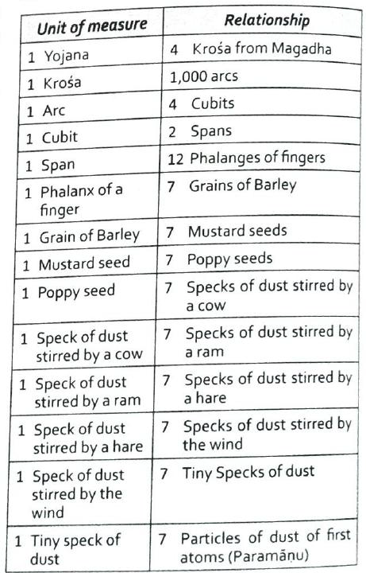
Small Numbers –Buddha’s reply to Arjuna

Slide 13
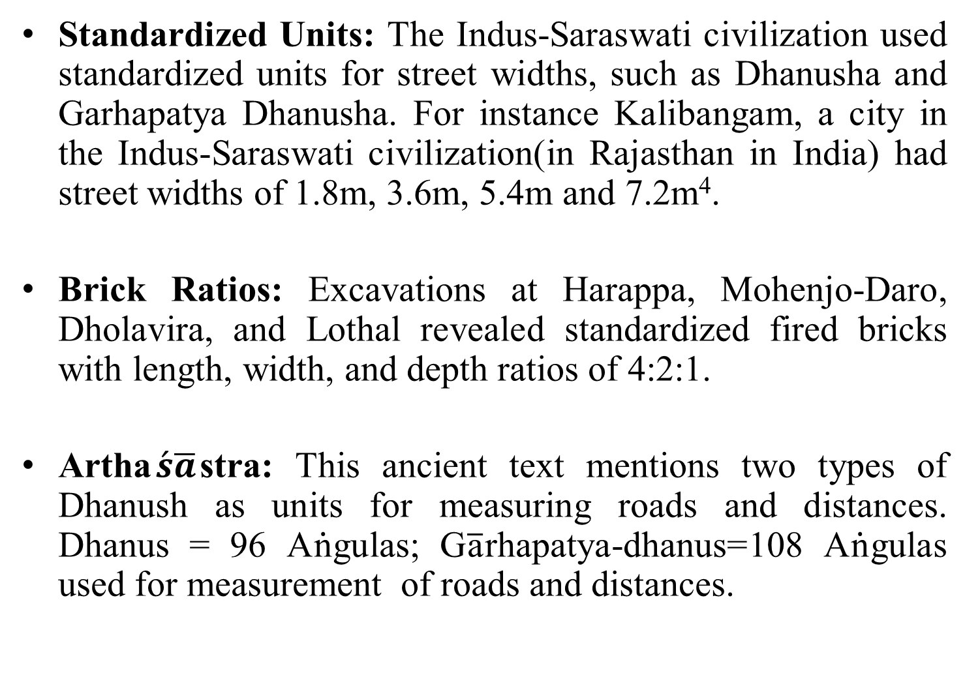
Indian Legacy in Units of Measurement
Standardized Units: The Indus-Saraswati civilization used standardized units for street widths, such as Dhanusha and Garhapatya Dhanusha. For instance Kalibangam, a city in the Indus-Saraswati civilization(in Rajasthan in India) had street widths of 1.8m, 3.6m, 5.4m and 7.2m⁴.
Brick Ratios: Excavations at Harappa, Mohenjo-Daro, Dholavira, and Lothal revealed standardized fired bricks with length, width, and depth ratios of 4:2:1.
Artha$\acute{s}\overline{a}$stra: This ancient text mentions two types of Dhanush as units for measuring roads and distances. Dhanus = 96 A$\dot{\text{n}}$gulas; G$\overline{\text{a}}$rhapatya-dhanus=108 A$\dot{\text{n}}$gulas used for measurement of roads and distances.

Slide 14
Unique ways to represent Numbers
Ancient Indian mathematics seamlessly integrated mathematics with literature and poetry.
When dealing with mathematical concepts and numbers, poetry was freely used to communicate the same. To do this, the numbers should have equivalent representations in terms of phrases and or alphabets.
Bhūta-Saṃkhyā system is a system of expressing numbers by means of words representing certain entities.
Kaţapayādi system employs a technique to convert the numerals to alphabets using certain rules.

Slide 15
Basic Principles of Bhūta-Sankhyā
Bhūta and Sankhyā: The word "Bhūta" refers to entities, beings, or concepts, while "Saṃkhyā" means number.
Association of Numbers with Entities: Each number from 0 to 9 is associated with specific entities or concepts. For instance, the number 2 is represented by the word "eye" since humans have two eyes.
Synonyms: To expand the scope of the system, synonyms are used for the entities. For example, the moon (Chandra) represents the number 1, and its synonyms like Sashi, Vidhu, Soma, and Indu can also be used.
Open-Ended List: The Bhūta-Sankhyā system is open-ended, allowing users to choose appropriate words based on the context and their preference.

Slide 16
Basic Principles of Bhūta-Sankhyā
For example,
'eye’ : 'two' since we know the pair of eyes is commonplace knowledge.
'guna’ : 'three' since tri-guņa is also a widely understood idea.
For Fractions: kală denotes ¹⁄₁₆ kustha denotes ¹⁄12 and śapha denotes ¹⁄8

Slide 17
Basic Principles of Bhūta-Sankhyā
No strict rules govern what qualifies to be used from the 'bhūta' list to represent the ‘samkhyā’. The following are some of the categories from which we frequently find words being used:
Word name for the number itself-śūnya, eka, dvi, tri ... Nava
Physical entities such as earth, moon, stars, mountain, fire, sky, direction
Examples from the animal kingdom such as elephant, horse, snake
Parts of the body eyes, limbs, seven dhātus, etc.
Names of Gods - Šiva, Vişņu, Indra, Manu, Agni, etc.
Other concepts - such as seasons, month, days, five bhūtas

Slide 18
Basic Principles of Bhūta-Sankhyā
It is up to the user to choose an appropriate word.
It is also contingent on the part of the reader to be aware of the terms and their synonyms.
The advantage of the system is the ability of the user to beautifully merge aesthetics and literature into mathematical ideas that he/she wants to communicate through some verses.

Slide 19
Word Numerals for Bhūta-Saṃkhyā System
Number | Represented by (Partial list only)
0 | Sunya. Anata, purna, kha
1 | Adi, candra, prithvi, eka
2 | Asvin, pairs of limbs, ayana, dvan
3 | Rama, guna, loka, kala, agni, trinetra
4 | Veda, sruti, yuga, asrama, varna, samudra, krta
5 | Bhuta, sastra, bana, pandava, indriya
6 | Anga, rtu, darsana, sanmukha, sat
7 | Rsi, adri, svara, dhatu, chandas
8 | Vasu, bhujanga siddhi, dik, kunjara, naga
9 | Graha, anka, nanda
10 | Dik,anguli, avatara, ranasiras
11 | Rudra
12 | Aditya, rasi
13 | Visva, kama
14 | Manu
15 | Tithi, dina

Slide 20
Bhūta-Saṃkhyā System - Examples
In ancient Indian Mathematics, the numbers are mentioned in the order of units, tens, hundreds, etc. (left to right).
veda-vedāńka-candräḥ : Let us split the words and associate the numbers to them. Veda (4); Veda (4): Anka(9); Candra(1). Therefore, the number is 1944.
khādri-rāmāgnayaḥ: Kha (0); Adri (7); Râma (3); Agni (3). Therefore, the number is 3370.
bhujanga-nanda-dvi-naga-anga-bana-sat-krita-indavaḥ: bhujanga (8), nanda (9), dvi (2), naga (synonym of adri) (7), anga (6), bâņa (5), sat(6), krta (4), indu (1). Therefore, the number is 146,567,298.

Slide 21
Madhavācārya's Approximation to π
Ancient Indian mathematicians have provided multiple approximations to π.
Many of these mathematical details, numbers and computations required are invariably provided in the form of some verses using word numeral systems such as bhūta-samkhyā system.
One such approximation is due to the 11th Century CE mathematician Madhavācārya.
The verse below contains the relevant details. Let us use the bhūta-samkhyā system to deciphers the details.

Slide 22
Madhavācārya's Approximation to π
vibudha-netra-gaja-ahi-hutāśana-triguna-veda-bha-vāraņa-bāhavaḥ ।
navanikharva-mite vrttivistare paridhimānam-idam jagadurbudhāḥ ॥
In the first line of the verse, numbers are provided using the bhūta-samkhya system.
Let us first extract the numbers. vibudha - Devas (33); netra - Eyes (2); gaja - Elephant (8); ahi - Snake (8); hutāśana - Agni (3); tri (3), guna - (3); veda (4) bha - stars (27); vāraņa - Elephant (8); bahu - Hands (2); Therefore, the number mentioned is 2,827,433,388,233.
In the second line of the verse, there is again a mention of a number; nava - (9); nikharva - 10¹¹. This number is 9 x 10¹¹.

Slide 23
Madhavācārya's Approximation to π
The balance part of the śloka mentions that this is the ratio of the circumference (paridhimānam) to the diameter (vrttivistare) of the circle.
Taking this ratio will yield us the value of π.
π = 2827433388233/ 9×10¹¹ = 3.14159265359222

Slide 24
Kațapayādi System
It's a system to convert the numerals to words is to associate a number to one or more alphabets.
Once this association is established, the numbers can be replaced with a corresponding alphabet.
Using the alphabet in the place of numbers, one can construct words, which by deciphering one alphabet at a time will reveal the number expressed in the word.
Used in Carnatic music.
Very similar to ASCII in modern days.

Slide 25
Kațapayādi System - Rules
The vowels when standing alone indicate the number zero. In all other cases when they are conjoined with consonants, they have no role in this system other than facilitating the pronunciation of the consonants when used in a word.
Each consonant is uniquely associated with a number from 0 to 9. For example, the consonants ka-ta-pa-ya was used to denote number 1. Therefore, the system was referred to as the Katapayadi system. Similarly, kha-tha-pha-ra denotes number 2, and so on.
More than one consonant may be associated with each of the numerals.
When more than one consonant is used in conjunction, only the terminal consonant preceding a vowel is to be considered for the identification of the corresponding numeral.
If a consonant is not conjoined with a vowel and stands alone, then it will not be considered for identification of the numeral.
Similar to the Bhūta-Saṃkhyā System, the numbers are to be read as units - tens hundreds ... etc.

Slide 26
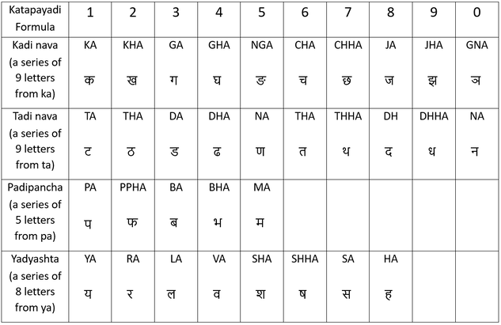
Kațapayādi System – Letter Numerals

Slide 27
Kațapayādi System - Examples
(bhavati) :Spliting them into separate letters bha-va-ti. After ignoring all the vowels and reading from the table the corresponding numbers, we get 4-4-6. Therefore, the is 644.
(śaktyāloke - śa-ktyā-lo-ke) :In this case, the second group has conjoined consonant 'k' followed by 't' and 'ya We ignore all the preceding ones and take only 'ya' for consideration. The resultant numbers for the string of these alphabets are ‘5-1-3-1. Therefore, the number is 1315.
(sarvārthaśīlasthiraḥ - sa-rvă-rtha-śī-la-sthi-rah) : As per the rules and the table, we have (7-4-7-5-3-7-2). Therefore, the number is 2,735,747.
(āyurarogyasaukhyam a-yu-rā-ro-gya-sau-khya-m) : In this case, there is a standalone vowel (a), which will indicate 0. There is a standalone consonant at the end (m), which will have to be ignored. The digits are 0-1-2-2 -1-7-1. Therefore, the number is 1,712,210.

Slide 28
Kațapayādi System - Advantages
Representing long (or large) numbers using a nice and easy-to-remember word, which can be easily remembered.
Particularly very valuable in an oral tradition, where large numbers may have to be remembered and communicated without loss of digits.
Very efficient method of presenting results of complex calculations using number symbols and then codifying and committing to memory effortlessly.

Slide 29
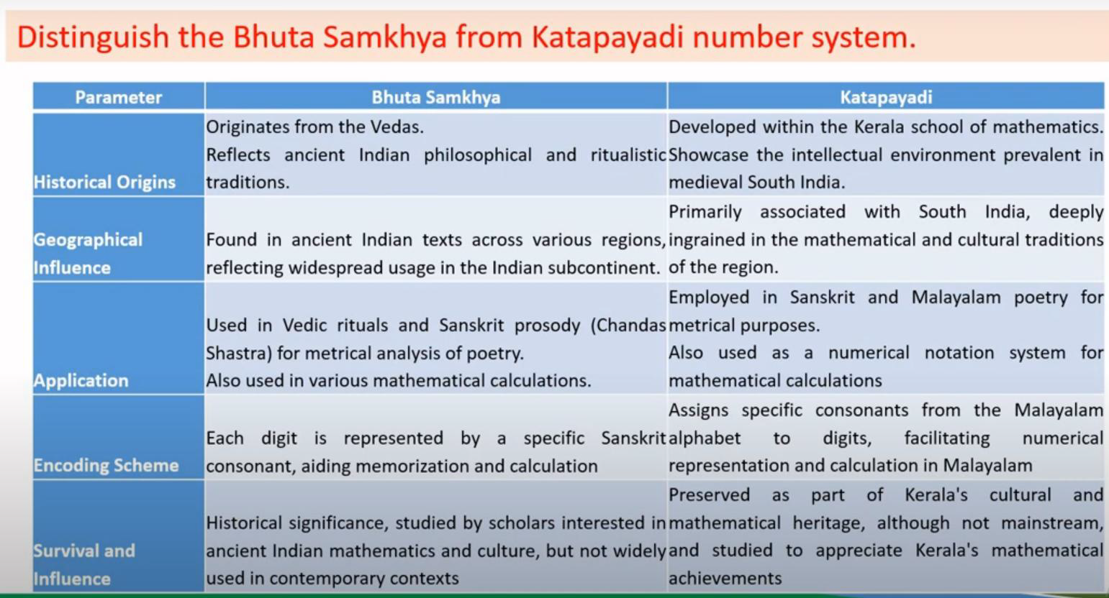

Slide 30
Measurements for time, distance and weight
In the Ancient Indian literature three fundamental physical measures for quantifying length, time, and weight are found.
There are several sources in the literature which specify units of measurements for these three physical quantities.
In Lilavati, Bhaskaracarya defined certain measures for length, volume, and mass.
Arthasastra provides the units of measurement for space, time, and weight.
Ayurvedic texts provide several measures for weight as these are used to measure ingredients while preparing a mixture of different substances.

Slide 31
Paramanu: The Smallest Unit
The concept of Paramanu in ancient Indian literature refers to the smallest indivisible unit of matter.
The time taken for light to pass through a Paramanu is considered the smallest measure of time, equivalent to 1.31 x 10⁻⁵ seconds.
The weight and length of a Paramanu represent the smallest units for these measures which are 2.88 x 10⁻⁷ mm and 1.31 x 10⁻⁵ seconds respectively.

Slide 32
Measures for Length
The units were based on multiples of 7, with 7 Paramanus making a Renu, 7 Renus making a Truti, and so on.
Larger units like Angula, Dhanurmusti, Prajapatya-hasta, Dhanus, Garhapatya-dhanus, Goruta, and Yojana were also used.
1 Angula is equivalent to 1.67 centimeters in modern terms.
A Dhanusha of 96 Angulas = 96 x 16.764mm = 1.609344m.
ADhanusha of108 Angulas = 108x16.764mm=1.810512m.
AYojana = 8000Dhanusha(of 108 Angulaseach)=8000x1.810512m=14.484096km.
14.484096 km = 9miles,(exactly!).
1000 Dhanushas of 96 Angulas each=1mile.

Slide 33
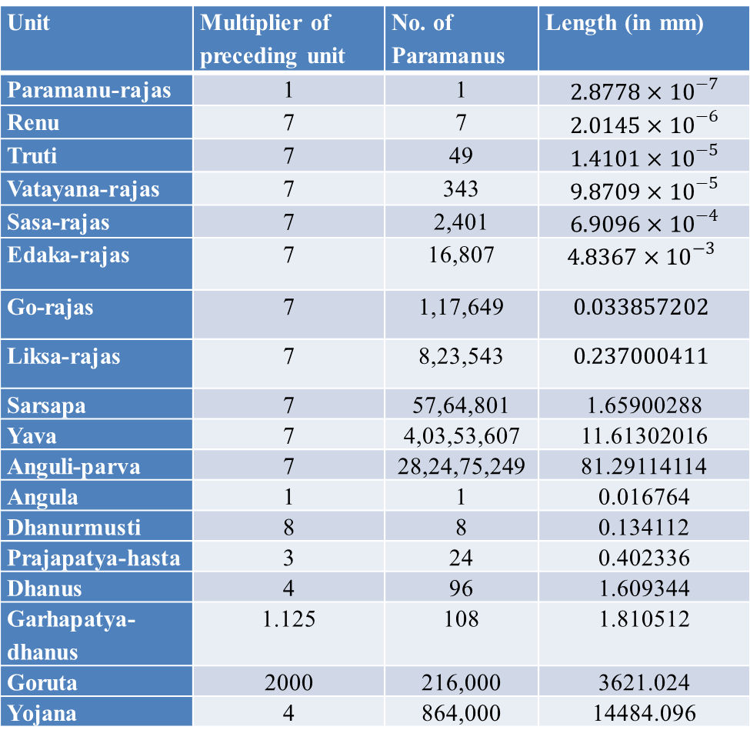
Ancient Indian Measures for Length
Unit | Multiplier of preceding unit | No. of Paramanus | Length (in mm)
Paramanu-rajas | 1 | 1 | ${2.8778×10}^{−7}$
Renu | 7 | 7 | ${2.0145×10}^{−6}$
Truti | 7 | 49 | $1.4101×{10}^{−5}$
Vatayana-rajas | 7 | 343 | ${9.8709×10}^{−5}$
Sasa-rajas | 7 | 2,401 | ${6.9096×10}^{−4}$
Edaka-rajas | 7 | 16,807 | $${4.8367×10}^{−3}$$
Go-rajas | 7 | 1,17,649 | $$0.033857202$$
Liksa-rajas | 7 | 8,23,543 | $$0.237000411$$
Sarsapa | 7 | 57,64,801 | 1.65900288
Yava | 7 | 4,03,53,607 | 11.61302016
Anguli-parva | 7 | 28,24,75,249 | 81.29114114
Angula | 1 | 1 | 0.016764
Dhanurmusti | 8 | 8 | 0.134112
Prajapatya-hasta | 3 | 24 | 0.402336
Dhanus | 4 | 96 | 1.609344
Garhapatya-dhanus | 1.125 | 108 | 1.810512
Goruta | 2000 | 216,000 | 3621.024
Yojana | 4 | 864,000 | 14484.096

Slide 34
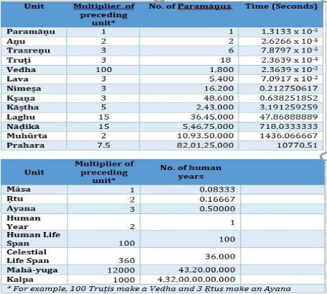
Measures for Time

Slide 35
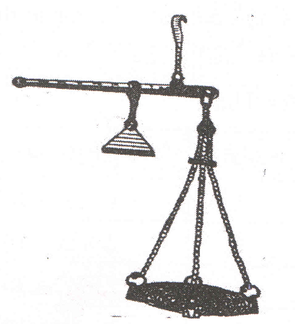
Measures for Weight -
Illustration of a balance during Mauryan

Slide 36
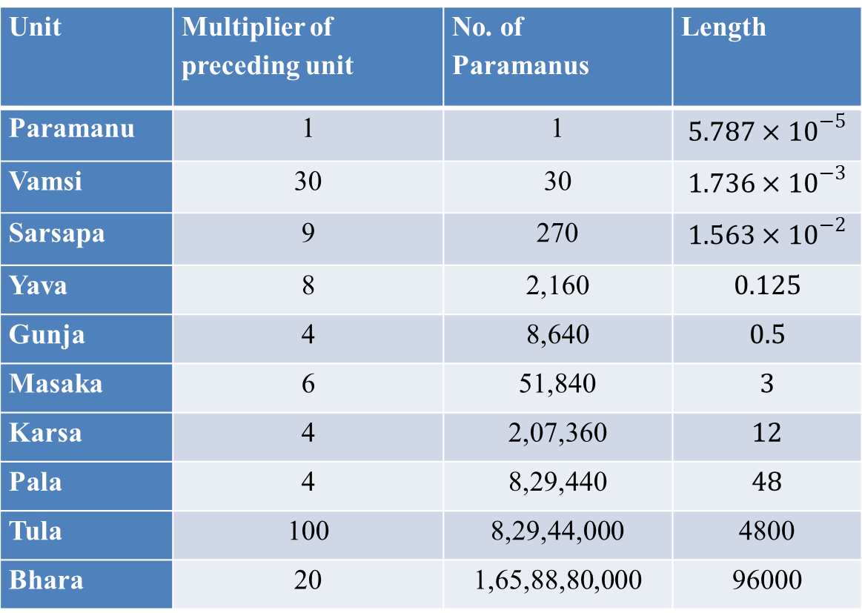
Ancient Indian measures for weight
Unit | Multiplier of preceding unit | No. of Paramanus | Length
Paramanu | 1 | 1 | ${5.787×10}^{−5}$
Vamsi | 30 | 30 | ${1.736×10}^{−3}$
Sarsapa | 9 | 270 | $1.563×{10}^{−2}$
Yava | 8 | 2,160 | $0.125$
Gunja | 4 | 8,640 | $0.5$
Masaka | 6 | 51,840 | $3$
Karsa | 4 | 2,07,360 | $12$
Pala | 4 | 8,29,440 | $48$
Tula | 100 | 8,29,44,000 | 4800
Bhara | 20 | 1,65,88,80,000 | 96000

Slide 37
Piṅgala and the Binary system
The Binary Number System is discovered in India.
It's discovered by Acharya Piṅgala in his Chhandasastra - a discussion on prosody (chhanda), the other Vedanga during 300 BCE.
However, the discovery of Binary Number System by Indians escaped the attention of Western Scholars. It may be because of its evidence in 'chandashāstra' a text related to description and analysis of meters in poetic literary work, totally unrelated to mathematics.
Binary Number System forms a basis of the modern digital world and modern logic. The two numbers “1” and “0” may be interpreted as either “on” and “off” or “true” and “false', or “magnetised” and “demagnetised”, or “laghu and guru” as in the case of 'chandashāstra' etc.
The German philosopher Gotfried Leibniz in 1695 rediscovered Binary Number System.

Slide 38
Piṅgala and the Binary system
Vedas are in the form of poetic verses and are written in different “meters” (Chandas).
Chandashāstra by 'Piṅgala' is the earliest treatise found on the Vedic Sanskrit meters.
Piṅgala defines different meters on the basis of the sequence of what are called laghu and guru (short and long) syllables and their number in the verse.
He has described different sequences that can be constructed with a given number of syllables and has also named them.
He also gave rules to list all possible combinations of laghu and guru (L and G) in a verse with 'n' syllables, rules to find out the laghuguru combinations corresponding to a given index, total number of possible combinations of 'n' LG syllables and so on.
In short Piṅgala describes the 'combinatorial mathematics' of meters in Chandashāstra.

Slide 39
Piṅgala's Chandashastra
Piṅgala mainly worked on Vṛttachandaḥ,
The vedic akṣarachandaḥ, referred to as Chandaḥ, are specified simply by the number of syllables. The later akṣarachandaḥ, called Vṛttachandaḥ, consist of 4 pāda, each pāda having a specified sequence of long and short syllables.
Poetic Literature follows certain rules. For example, the length of each line will be specified in terms the number of syllables. Combination of syllables in terms of vowels and consonants (long and short forms) to be used is also specified.

Slide 40
Piṅgala's Chandashastra – Understanding Laghu and Guru
Piṅgala's Chandah-śastra dealt with rules governing prosody. The basic building block of poetry is a syllable. A syllable is a vowel or a vowel with one or more consonants preceding it. There are two types of syllables defined by Piṅgala in the Chandah-śastra.
Laghu (Short Syllable) - Any syllable with a short vowel
Guru (Long Syllable) can be of four varieties:
Any syllable with a long vowel.
Any short syllable followed by conjunction of consonants.
Any short syllable followed by 'm' known as anusvåra or visarga denoted by ‘:’
The last syllable in the quarter of a meter (optionally).

Slide 41
Piṅgala's Chandashastra – Understanding Laghu and Guru
Let us take a verse to understand this classification.
yadā yadā hi dharmasya glänirbhavati bhārata ।
abhyutthanamadharmasya tadātmānam sṛjāmyaham ॥
Using the above rules for laghu and guru, Laghu is labelled as ‘L’ and guru as ‘G’

Slide 42
Piṅgala's Chandashastra – Understanding Laghu and Guru
ya | dā | ya | dā | hi | dha | rma | sya | glā | ni | rbha | va | ti | bhā | ra | ta
L | G | L | G | L | G | G | G | G | G | L | L | L | G | L | G
a | bhyu | ttha | na | ma | dha | rma | sya | ta | dā | tmā | nam | sṛ | jā | mya | ham
G | G | G | L | L | G | G | G | L | G | G | G | L | G | L | G

Slide 43

Laghu and Guru

Slide 44
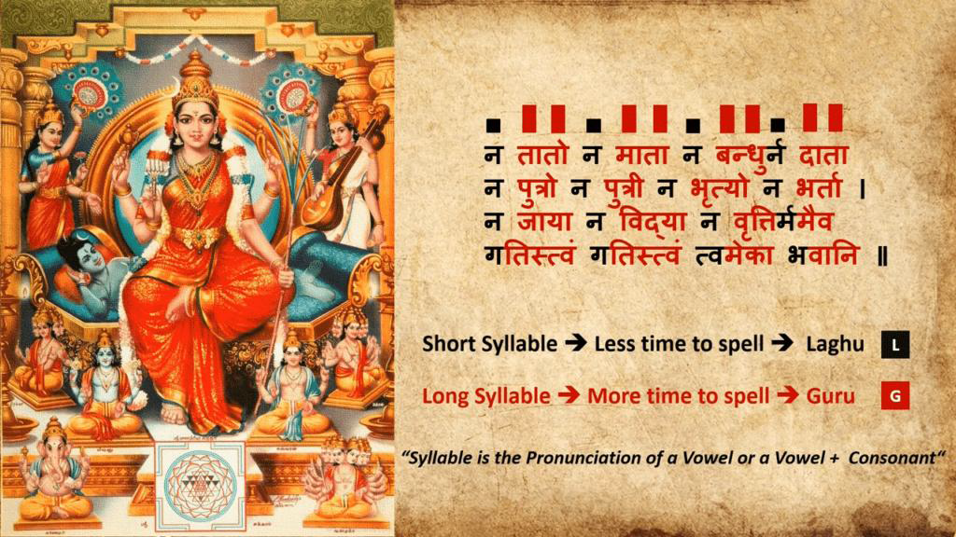
Laghu and Guru

Slide 45
Bhavani ashtakam - Analysis
Every quarter of Bhavani ashtakam consists of 12 letters. The pattern or the order of arrangement of syllables in each quarter is
LGG LGG LGG LGG
Here, G is Guru and L is Laghu syllable.
This metre is called भुजङ्गप्रयातम् (Bhujangaprayatam, snake-like advancing).
For a quarter having 12 letters, one can have 2^12 = 4096 different arrangements of Guru and Laghu syllables.
This means that you can have 4096 different metres with a quarter consisting of 12 letters.

Slide 46
Ganas
Every quarter in a pada is represented by a combinations of gurus and lagghus of length three.
There are eight unique combination of laghu and guru (binary) one can obtain . Pingala defined 8 categories of these building blocks called ‘Ganas’
Each gana make a unique combination of laghu and guru

Slide 47
Eight Ganas Defined by Pingala
Sl. No. | Gana Name | Binary Word
1 | ‘Ya’ Gana | 100
2 | ‘Ma’ Gana | 000
3 | ‘Ta’ Gana | 001
4 | ‘Ra’ Gana | 010
5 | ‘Ja’ Gana | 101
6 | ‘Bha’ Gana | 011
7 | ‘Na’ Gana | 111
8 | ‘Sa’ Gana | 110

Slide 48
Eight Ganas Defined by Pingala
There is an easy to remember mnemonic for the composition of the eight ganas given by the following short phrase:
Yamata-raja-bhana-salagam
Analysing the phrase using the rules of laghu and guru and converting into a binary word we get the result as presented in table:
ya | mā | tā | rā | ja | bhā | na | sa | la | gam
L | G | G | G | L | G | L | L | L | G
1 | 0 | 0 | 0 | 1 | 0 | 1 | 1 | 1 | 0

Slide 49
Eight Ganas Defined by Pingala
Using the binary cycle we can generate all the 8 unique combinations of the binary word of length three that constituted the eight ganas.
For example, from the point indicated as ‘begin’, we can progressively derive all the 8 ganas and their binary composition taking three consecutive binary numbers at a time , ‘1-0-0’ forms the ‘ya’ gana, ‘0-0-0’ forms the ‘ma’ gana and so on.
This method of string generation was discovered using combinatorial mathematics known as the De Brujian sequence. It is a sequence of order’n’ on an alphabet A of size ‘k’ in which every possible length ‘n’ string on A occurs exactly once as a substring.
Pingala demonstrated this for k = 2 (laghu, guru) and n = 3(gana of size 3)

Slide 50
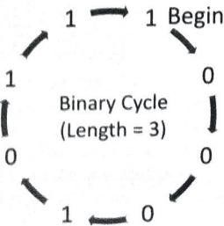
Binary Cycle of Length 3

